Slide 1

Data Warehousing and Data Mining
Audio_Lec_03
Notes:
AoA Students, Welcome to another lecture of our audio based lectures series. In the last lecture, we started discussion on ETL by elaborating topics related to data transformation and data loading. In today’s lecture, we will discuss about data quality management and indicators of data quality.

Slide 2

Data Quality Management
It is important to ensure that the data is correct to make right decisions
Imagine the user working on operational system is entering wrong regions’ codes of customers. Imagine that the relevant business has never sent an invoice using these regions codes (so they are ignorant). But what will happen if the data warehouse will use these codes to make decisions?
You need to put proper time and effort to ensure data quality
Notes:
So why data quality is important? It is important to ensure that the data is correct to make right decisions. An incorrect data will lead to wrong decisions which can harm to achieve an organization’s goals.
In this context, imagine a user working on operational systems and that user is entering wring regions’ codes of customers. Also imagine that the relevant business has never sent an invoice using these regions codes. So the decision makers are ignorant about the wrong region codes. But what will happen if the data warehouse will use these code to help in making decisions. Off course, any decision on the basis of wrong information will also be wrong. Therefore, you need to put proper time and effort to ensure data quality.
Please move to the next slide.

Slide 3

Data Quality
What is Data: An abstraction/representation/
description of something in reality
What is Data Quality: Accuracy + Data must serve its purpose/user expectations
Notes:
So what is data and what is meant by data quality.
The data is an abstraction/representation/description of something in reality. While the data quality means that the data is accurate and it must serve its purpose or user expectations. Remember, in DW we always strive to gather accurate data and we also make efforts that the collected should help in making strategic decision making. This means that our data must serve its purpose to provide strategic information to decision makers.
Please move to the next slide.

Slide 4

Indicators of quality of data
Accuracy: Correct information, e.g., address of the customer is correct
Domain Integrity: Allowable values, e.g., male/female
Data Type: If a field requires text then no numeric entries
Consistency: The content and its form is same across all source system, e.g., product code of a product ABC in one system is 1234 then in other system it must be 1234 for that particular product
Notes:
While working with operational systems or DW there are various indicators of data quality
Accuracy: The accuracy means correct information. For example, the stored addresses of customers is correct. We need to verify that wrong information has not been entered.
Domain Integrity: Domain integrity means that only allowable values are in your database. For example, if a field stores gender information then it can store only ‘male’ or ‘female’ as valid values. There are no other values in the field.
Data Type: If a field requires text then no numeric entries or vice versa.
Consistency: This means that the content and its form is same across all source systems. For example, product code of a product ABC in one system is 1234 then in other system it must be 1234 for that particular product.
Please move to the next slide.

Slide 5

Indicators of quality of data (Cont.)
Redundancy: Data is not redundant, if for some reason for example efficiency the data is redundant then it must be identified accordingly
Completeness: There are no missing values in any field and only valid values
Conformance to Business rules: Values are according to the business constraints, e.g., loan issued cannot be negative
Well defined structure: Whenever the data item can be divided in components it must be stored in terms of components/well structure, e.g., Muhammad Ahmed Khan can be structured as first name, middle name, last name. Similar is the case with addresses
Notes:
5. Redundancy: This means that data is not redundant. If for some reason, for example efficiency, the data is redundant then it must identified and resolved accordingly for the DW.
6. Completeness: This means that there are no missing values in any field and only valid values. For example, if a record keeps details of an order then it should contain all information related to that order in its corresponding fields. Which means that there is not any missing value.
7. Conformance to Business rules: This means that values in any field are according to the business constraints. For example, the loan issued cannot be negative.
8. Well Defined Structure: The means that whenever the data item can be divided in components, it must be stored in terms of components or well structure. For example, Muhammad Ahmed Khan can be structured as first name, middle name, and last name. Similar is the cases with address where street address, zip code, city, and country information can be stored in different fields. By such structure the decision makers can retrieve more well organized information, for example, performance of a store, city, or a country.
Please move to the next slide.

Slide 6

Indicators of quality of data (Cont.)
Data Anomaly: Fields must contain that value for which it was created, e.g., State field cannot take the city name
Proper Naming convention
Timely: timely data updates as required by user
Usefulness: The data elements in data warehouse must be useful and fulfill the requirements of the users otherwise data warehouse is not of any value
Notes:
9. Data Anomaly: It means that fields must contain that value for which it was created. For example, state field cannot take the city name.
10. Proper naming convention: This means that proper naming conventions have been used to store data. Such naming conventions allows to better understanding of data and its purpose.
11. Timely: The means that data is timely updated in DW as required by its users.
12. Usefulness: This means that the data elements in DW must useful and fulfill the requirement of the users otherwise data warehouse is not of any value.

Slide 7
Indicators of quality of data (Cont.)
Entity and Referential Integrity: Entity integrity means every table must have a primary key and it must be unique and not null. Referential integrity enforces parent child relationship between tables, you can not insert a record in child table unless you have a corresponding record in parent table
Notes:
13. Entity and referential integrity: Entity integrity means that every table must have a primary key and it must be unique and not null. If entity integrity is not enforced then a table might have duplicate records and, moreover; we will not be able to uniquely identify any record.
The referential integrity on other hand enforces parent child relationship between table. This means that you cannot have a record in child table unless you have a corresponding record in parent table. If it is not enforced, then it is quite possible that, for example, an order table (child) may have records that have no corresponding record in customer table (parent). The lack of referential integrity will allow your tables to have dirty records in your database.

Slide 8
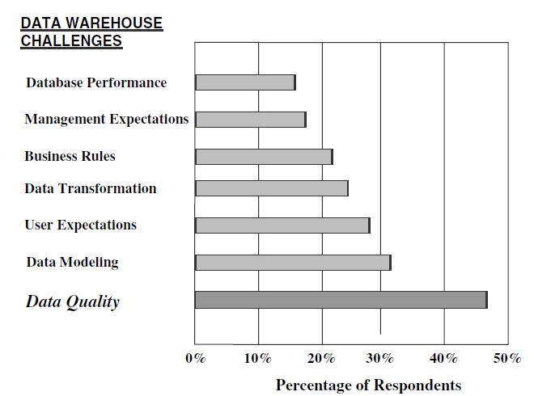
Problems due to quality of data
Businesses ranked data quality as the biggest problem during data warehouse designing and usage
Notes:
So how much data quality is important. Please look at this figure. The figure shows the results of a survey which asked businesses about their biggest challenge in designing and using data warehouses. It can be observed that nearly half of the business ranked data quality as the biggest challenge, even more than the data modeling.
I would like to conclude my lecture here. In the next lecture we will discuss the possible causes of low quality data and sources of data pollution. We will also see a list of different tools that can be used for data cleansing. So see you in next lecture, till then Allah Hafiz and stay safe.

